Slide 1
Trade and Tariffs
Lesson 4
Notes:
Title slide. Welcome students back. 'Today we're going to explore one of the biggest economic topics in the news right now—trade and tariffs. By the end of today, you'll be able to explain why countries trade, what happens when governments put taxes on imports, and who really pays the price.'

Slide 2
Where was your phone made?
What about your shoes? Your shirt?
Check the labels on 3 things you have with you right now.
Write down the country for each one.
Notes:
SEGMENT 1 — Opening Hook (7 min). Have students check labels on shoes, shirt, phone, backpack, etc. Give them 2 minutes to check 3 items. Then go around the room and list countries on the board. You'll likely get: China, Vietnam, Bangladesh, India, Mexico, etc. Say: 'Look at this list—your everyday stuff comes from all over the world. What if you could only buy things made in the U.S.? What would change?'

Slide 3
How many countries are in this room?
Imagine if everything had to be made here.
What would cost more? What might disappear entirely?
Notes:
After listing countries, ask: 'What if none of this trade existed? Would your phone cost the same? Would you even have the same phone?' Let a few students respond. This sets up the idea that trade gives us access to things we couldn't easily make ourselves, or couldn't make as cheaply. Transition: 'Before we define any of this formally, let's play a game that shows WHY trade happens.'

Slide 4
Quick polls
Thumbs up / thumbs down:
1. "Tariffs protect American jobs."
Agree? Disagree? Not sure?
2. "International trade is mostly good for the U.S."
Agree? Disagree? Not sure?
Notes:
Quick informal polls—thumbs up, thumbs down, or sideways for 'not sure.' Don't correct anyone here. Say: 'We're going to come back to these questions at the end of class and see if anyone changed their mind.' Note the rough split on the board or just mentally. This gives you a baseline for where students are starting.

Slide 5
🍬 The Candy Trading Game
Notes:
SEGMENT 2 — Interactive Game (20 min). Transition: 'Alright, time for the fun part. We're going to do an experiment with candy.' Distribute the random candy bundles now. Each student gets 3-5 pieces of assorted candy. Make sure the mix is random—some students will get candy they love, others will get stuff they don't want. That's the point.

Slide 6
Game Rules
Round 1: Rate your candy bundle 1–10. No trading.
Round 2: Form small groups (3–4). Trade within your group only.
Rate your bundle again.
Round 3: Trade with ANYONE in the class.
Rate your bundle one last time.
Rule: No one can be forced to trade. Every trade is voluntary.
Notes:
Walk through each round clearly. Emphasize: VOLUNTARY trades only. Nobody has to give up anything they don't want to. Have students write their rating (1-10) on a slip of paper or just raise fingers after each round. You'll collect these mentally or on the board. Key: between rounds, remind them to think about WHY they want to trade and what makes a trade 'worth it' to both sides.

Slide 7
What to watch for
👀 Did anyone's rating go DOWN after trading?
👀 Did more people get what they wanted in Round 2 or Round 3?
👀 Why would you ever agree to a trade?
Notes:
Display this during the game so students are thinking about it. After all three rounds, collect the data. Write average ratings for Round 1, Round 2, Round 3 on the board. The pattern should be: ratings go up (or at worst stay the same) with each round. No one's rating should go down, because no one was forced to trade. This is the key insight.

Slide 8
Debrief
1. What happened to the average rating across the three rounds?
2. Did anyone's rating go down? Why not?
3. Why were more trades possible in Round 3 than Round 2?
No one was forced to trade — so every trade made at least one person better off and no one worse off.
Notes:
Debrief questions. Expected answers: (1) Ratings went up each round. (2) No—because every trade was voluntary. If it would have made you worse off, you just wouldn't do it. (3) Bigger group = more potential trading partners = more chances to find someone who has what you want and wants what you have. Transition: 'What you just experienced has a name in economics. Let's put the formal terms on it.'

Slide 9
Trade
The voluntary exchange of goods or services between people, businesses, or countries
Remember the candy game?
Every swap you made was a trade. It was voluntary — and that's the key.
Notes:
SEGMENT 3 — Lecture (18 min). Start connecting the game to formal concepts. 'What you did with the candy—swapping Skittles for Reese's—that's trade. The same thing happens between countries, just on a massive scale. The U.S. trades with over 200 countries every year.'

Slide 10
Gains from Trade
The increase in well-being that comes from trading — both sides benefit, or they wouldn't trade
Your ratings went UP each round.
That improvement? Those are gains from trade.
Notes:
'Remember how your ratings went up each round? That increase in happiness—economists call that gains from trade. Both sides benefit from a voluntary exchange, or else they wouldn't agree to it. That's why nobody's rating went down.' Key point: trade is not zero-sum. One person's gain does NOT have to be another person's loss. This is a common misconception—address it directly.

Slide 11
Why trade works
🇺🇸 United States
Good at: technology, agriculture, finance, entertainment
Less efficient at: low-cost manufacturing
🇻🇳 Vietnam
Good at: low-cost manufacturing (clothing, electronics assembly)
Less efficient at: high-tech R&D
Both countries are better off specializing and trading — just like you were better off trading candy
Notes:
'Countries are like the students in our game—everyone has different stuff and different preferences. The U.S. is really good at making software, growing soybeans, and making movies. Vietnam is really good at making clothing cheaply. If each country focuses on what it does best and then trades, both end up with MORE than if they tried to do everything themselves.' Draw the analogy: 'In the candy game, you didn't all start with the same candy. That's why trade was valuable—you had different things and different preferences.'

Slide 12
Imports and Exports
Imports = goods coming IN to a country
(your phone, made in China, imported to the U.S.)
Exports = goods going OUT of a country
(U.S. soybeans, shipped to China)
Notes:
Simple definitions. Connect back to the label check: 'All those countries on the board? Those are where your imports come from. Your phone was manufactured in China and imported to the U.S. Meanwhile, the U.S. exports things like soybeans, airplanes, and software to other countries.' Memory trick: 'Imports come IN. Exports EXIT.'

Slide 13
More trading partners = more gains
Round 2: Small group only → some improvement
Round 3: Whole class → biggest improvement
The same idea applies to countries.
More trade partners → more opportunities → more gains.
Notes:
'Why did ratings go up MORE in Round 3 than Round 2? Because you had more people to trade with. The bigger the market, the more likely you'll find someone who has exactly what you want. This is the same reason countries benefit from trading with LOTS of other countries, not just one or two.' This sets up the tariff discussion—tariffs restrict who you can trade with (or make it more expensive), which reduces gains from trade.

Slide 14
Tariff
A tax on imported goods
Paid at the border by the importer (typically a domestic firm)
A tariff does not apply to goods that are produced and sold domestically
Notes:
'A tariff is a tax the government puts on goods coming in from other countries. Here's the candy version: imagine that in Round 3, every time you wanted to trade with someone, you had to give me one piece of candy as a fee. Would you have traded as much? Probably not. Would your rating have been as high? Probably not. That's exactly what a tariff does—it makes trade more expensive, which means some trades that would have made people better off just don't happen.' Key misconception to address: 'Who pays the tariff? Many people think the other country pays it. But the tariff is paid by the IMPORTER—an American company—and that cost usually gets passed on to YOU, the consumer, through higher prices.'

Slide 15
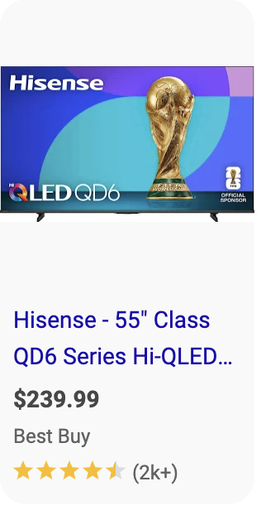
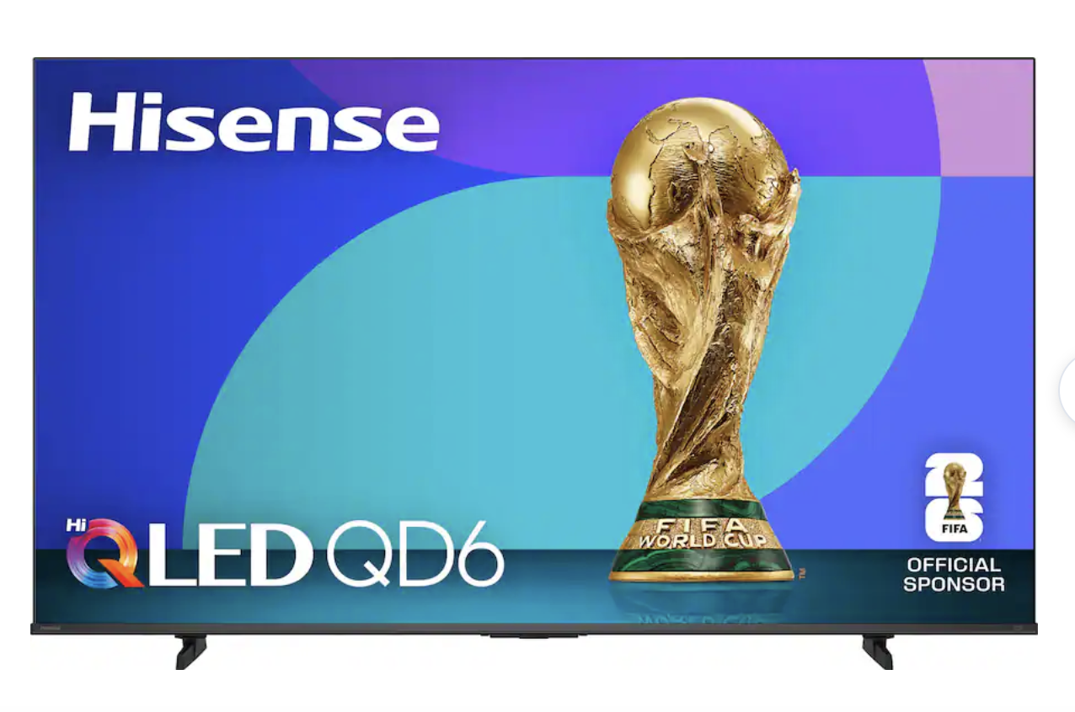

Chinese firm makes the TV
Best Buy imports the TV
Best Buy sells to U.S. customers
The importer is required pay the tariff to the U.S. Customs and Border Protection Service

Slide 16
Chinese firm makes the TV
Best Buy imports the TV
Best Buy sells to U.S. customers
Who ultimately bears the cost of the tariff?

Slide 17
Chinese firm makes the TV
Best Buy imports the TV
Best Buy sells to U.S. customers
How might the two firms adjust their prices?
Notes:
Stop and ask the class what they think. Answer: It depends. But most of the time the firms raise their prices to cover the tariffs, and so the end customers – you and I -- end up paying. That is why tariffs are sometimes referred to as a “tax on American consumers”

Slide 18
Chinese firm makes the TV
Best Buy imports the TV
Best Buy sells to U.S. customers
How might other US TV manufacturers adjust their prices in response
Notes:
Stop and ask the class what they think. Answer: It depends. But most of the time the firms raise their prices to cover the tariffs, and so the end customers – you and I -- end up paying. That is why tariffs are sometimes referred to as a “tax on American consumers”

Slide 19
Who bears the cost of the tarrif?
Best Buy pays the tariff at the border when the TVs enter the U.S., raising their cost per unit
Best Buy passes that higher cost to shoppers by raising their prices — American consumers pay more
Hisense may feel pressure to lower their prices to stay competitive, squeezing their profit margins — but they may not have much room to lower their prices if their margins are already thin
Unlike a sales tax you can see on your receipt, tariff costs are hidden inside the sticker price — consumers often don't realize they're paying it
Notes:
'So if tariffs make things more expensive, why would a government ever use them? There are a few reasons.' Walk through each. Emphasize that these are real arguments people make, and we'll evaluate them in our policy debate. 'The question isn't whether tariffs exist—they do. The question is whether the benefits are worth the costs. That's the economic way to think about it.' Transition to break: 'Take 5 minutes. When we come back, we're going to look at a real tariff that's in the news right now and decide: is it worth it?'

Slide 20
Why governments use tariffs
1. Protect domestic industries
Make foreign goods more expensive so people buy American
2. National security
Keep critical industries (steel, chips) alive at home
3. Raise revenue
Government collects money from the tax
Notes:
'So if tariffs make things more expensive, why would a government ever use them? There are a few reasons.' Walk through each. Emphasize that these are real arguments people make, and we'll evaluate them in our policy debate. 'The question isn't whether tariffs exist—they do. The question is whether the benefits are worth the costs. That's the economic way to think about it.' Transition to break: 'Take 5 minutes. When we come back, we're going to look at a real tariff that's in the news right now and decide: is it worth it?'

Slide 21
☕ 5-minute break
Notes:
5-minute break.

Slide 22
Economic analysis:
Should the U.S. keep tariffs on imported steel?
Notes:
SEGMENT 4A — Introduce the Policy Debate (7 min). 'Welcome back. We just learned what tariffs are and why governments use them. Now let's look at a real case: steel tariffs. The U.S. has placed tariffs of 25% on imported steel. The argument is that we need to protect American steel workers and keep steel production in the U.S. for national security reasons. But there's a catch...'

Slide 23
The steel tariff story
2018: U.S. places 25% tariff on imported steel
Reason: "Protect American steel jobs" + national security
Result: Steel prices in the U.S. went up ~20% in 2018
But... Steel is an INPUT for other industries
(cars, construction, appliances, cans)
Those industries now pay MORE for steel → higher costs → higher prices for you

Slide 24
Your analysis framework
COSTS of steel tariffs
BENEFITS of steel tariffs
(fill this in with your group)
(fill this in with your group)
Use your handout to organize your thinking — consider: who wins, who loses, and what's the tradeoff?

Slide 25
Discussion questions
1. If tariffs protect 140,000 steel jobs but raise costs for 6.5 million workers in other industries, is it worth it?
2. Should the government protect an industry even if it makes things more expensive for everyone?
3. What if steel is needed for tanks and warships — does national security change the calculation?
4. Connect to the candy game: what if I had charged a "fee" for every Round 3 trade — who would have been worse off?

Slide 26
Debrief
What economic concept was most useful in thinking through the tariff debate?
Did anyone change their mind? What argument moved you?
Let's revisit our opening polls...
Notes:
Quick debrief. Ask 2-3 students to share. Then re-poll: 'Thumbs up/down—tariffs protect American jobs. Has anyone moved?' and 'International trade is mostly good for the U.S.—any changes?' Compare to the opening. Usually you see more nuance after the lesson—students who were firmly one way start to see the other side. That's the goal: not to tell them what to think, but to give them the tools to think it through.

Slide 27
Key takeaways
1. Trade is voluntary exchange — both sides benefit (gains from trade)
2. Imports come IN, exports go OUT — your stuff comes from all over the world
3. A tariff is a tax on imports — paid by the importer (and ultimately consumers)
4. Tariffs create winners and losers — evaluating them requires thinking about tradeoffs
Notes:
Recap the four key takeaways. Read each one aloud. 'These four ideas are the core of what you need to take away from today. You experienced gains from trade with the candy. You saw that your stuff comes from dozens of countries. You learned that tariffs are taxes on US consumers. And you debated whether the tradeoffs are worth it.'

Slide 28
Thank you!
Notes:
End of lesson. Collect exit tickets. Remind students of next lesson topic if applicable.

